Slide 1


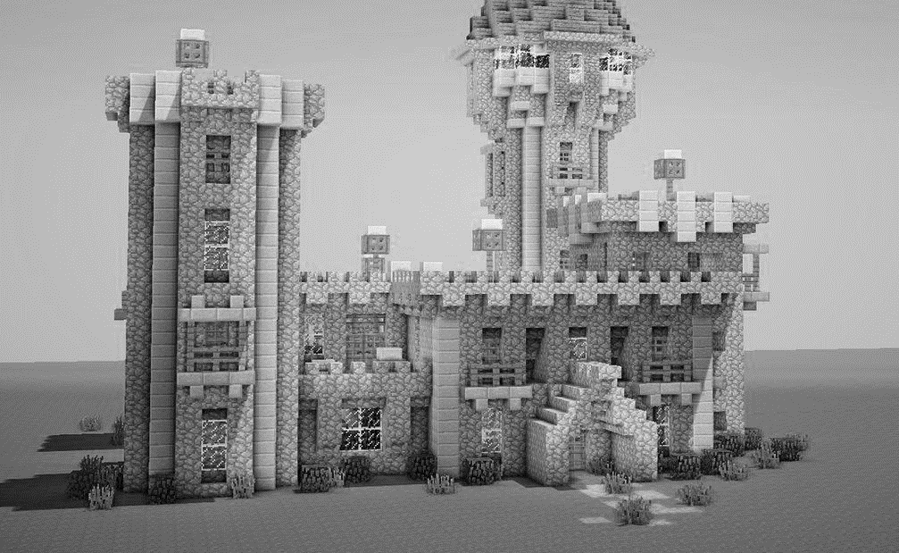
Pitch

Slide 2


Pitching for a project
A pitch is when you go talk to a prospective client and persuade them to work with you.
You’re pitching your ability and ideas to do the project right.
People want to know if you understand and can fix their problems.
Remember that these people have probably fought tooth and nail to get the budget for this project. They have a pain point and they’re shopping around for the right person to help ease their pain. Show them you’re that person.

Slide 3



tips
Elevator pitch, use the first 90 seconds of your pitch to hook them in
Confidence
Innovation; how unique and how different your idea is and what benefits it offers.
How will you measure success.
Inject a bit of “wow” - exceed their expectations, include a bit of playfulness, make them smile

Slide 4

30 minutes
Complete the pitch
Student present in a random order

Slide 5
Hand in your pitches
There is a hand in point in Teams
Upload your pitch
We will compare the pitch to the delivered product

